Slide 2
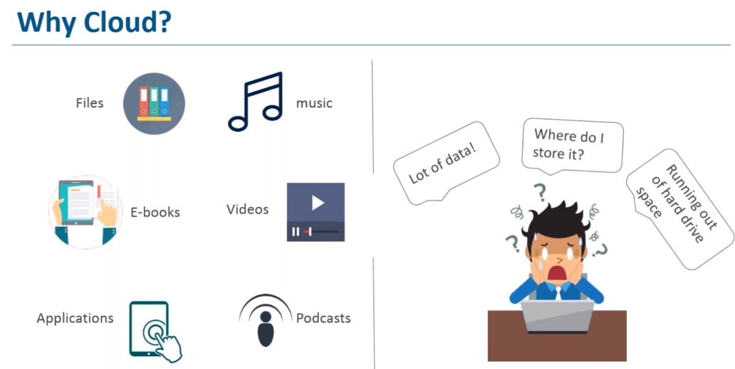

Slide 3
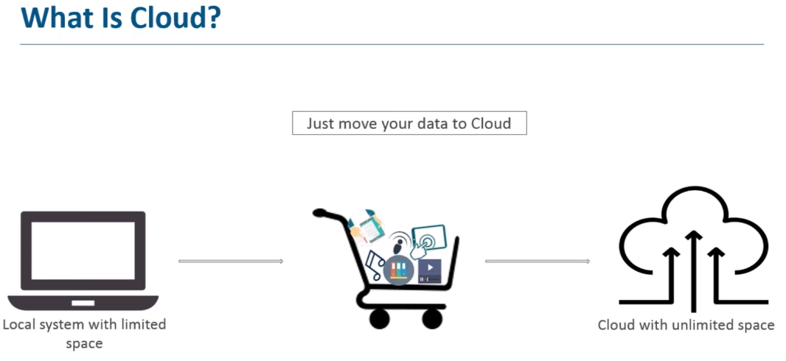

Slide 4
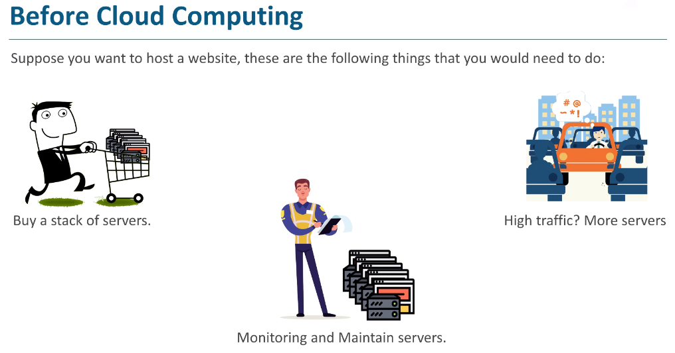

Slide 5
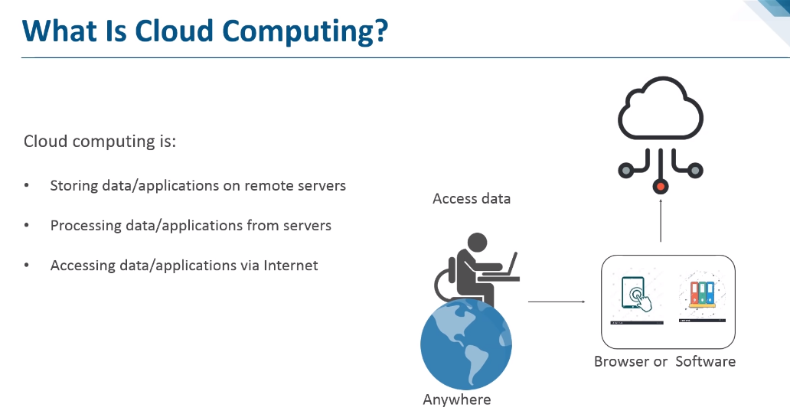

Slide 6
What is Cloud Computing?
Cloud Computing is defined as storing and accessing of data and computing services over the internet.
It doesn't store any data on your personal computer. It is the on-demand availability of computer services like servers, data storage, networking, databases, etc.
The main purpose of cloud computing is to give access to data centers to many users. Users can also access data from a remote server.
Examples of Cloud Computing Services:
AWS, Azure, Google Cloud

Slide 7
Cloud Computing basics with an example –
Whenever you travel through a bus or train, you take a ticket for your destination and hold back to your seat till you reach your destination.
Likewise other passengers also takes ticket and travel in the same bus with you and it hardly bothers you where they go.
When your stop comes you get off the bus thanking the driver.
Cloud computing is just like that bus, carrying data and information for different users and allows to use its service with minimal cost

Slide 8
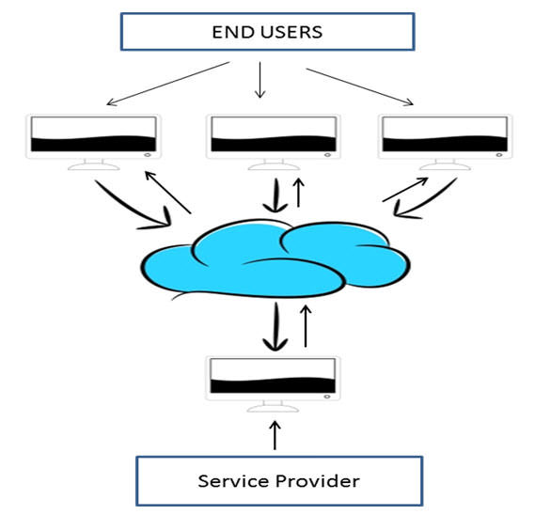
Why the Name Cloud?
The term “Cloud” came from a network design that was used by network engineers to represent the location of various network devices and there inter-connection.
The shape of this network design was like a cloud.

Slide 9
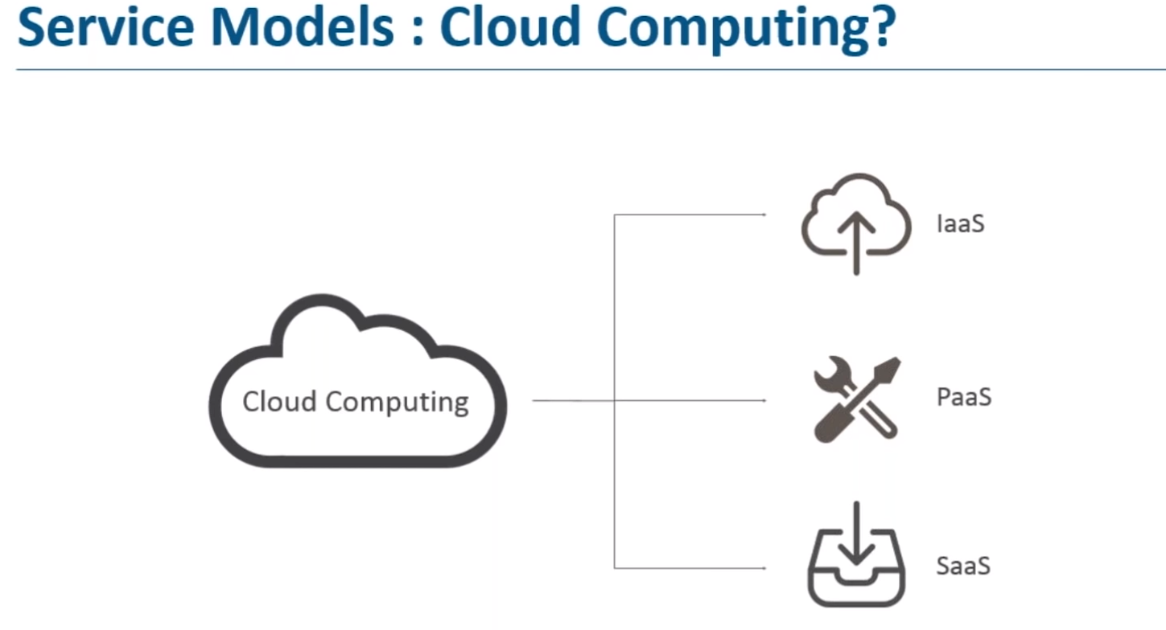
Software as a Service (SaaS)
Platform as a Service (PaaS)
Infrastructure as a Service (IaaS)

Slide 10
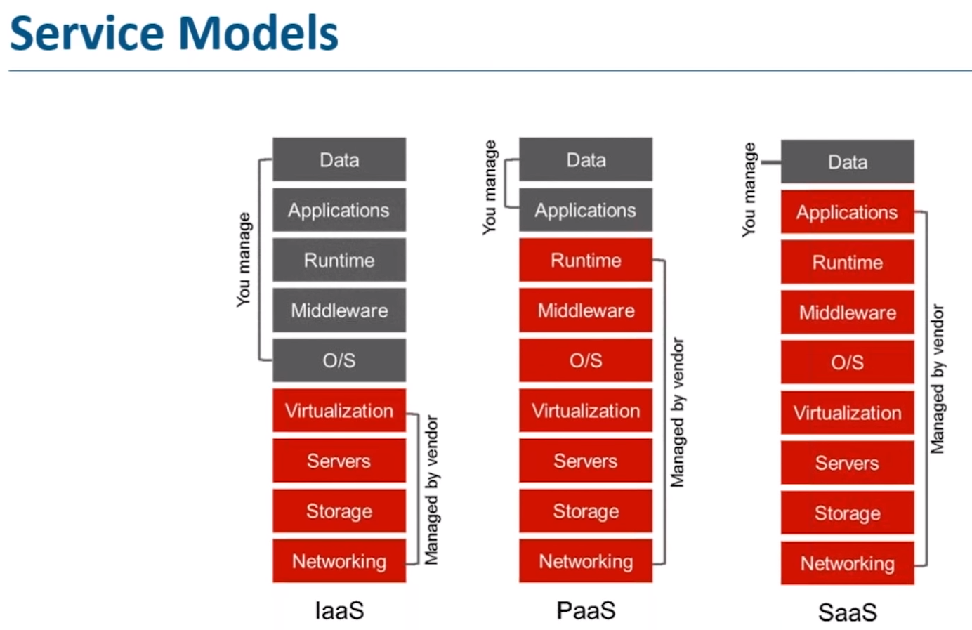

Slide 11
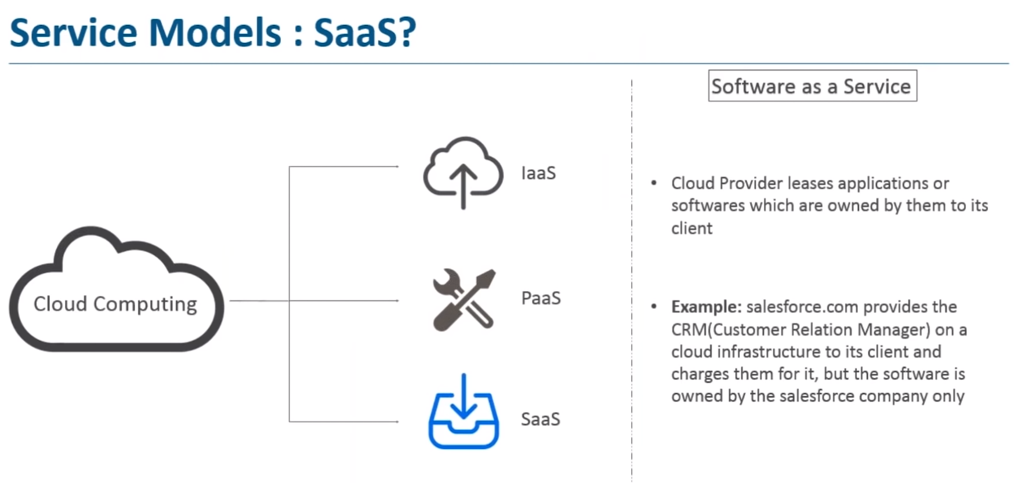

Slide 12
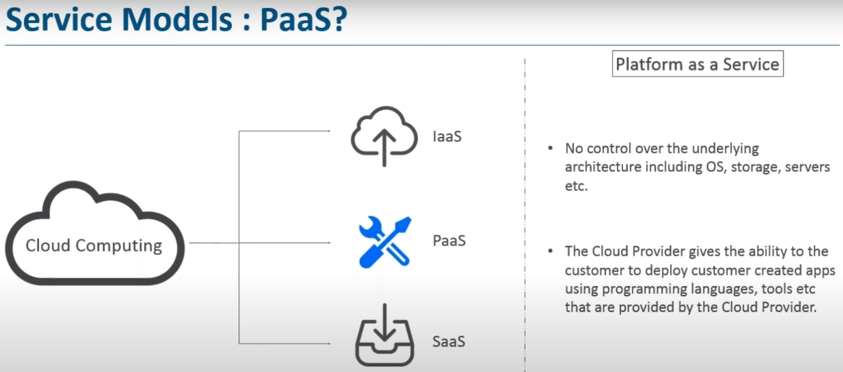

Slide 13

PaaS (Platform as a Service)
Platform as a service, is referred as PaaS, it provides a platform and environment to allow developers to build applications and services. This service is hosted in the cloud and accessed by the users via internet.
To understand in a simple terms, let compare this with painting a picture, where you are provided with paint colors, different paint brushes and paper by your school teacher and you just have to draw a beautiful picture using those tools.

Slide 14
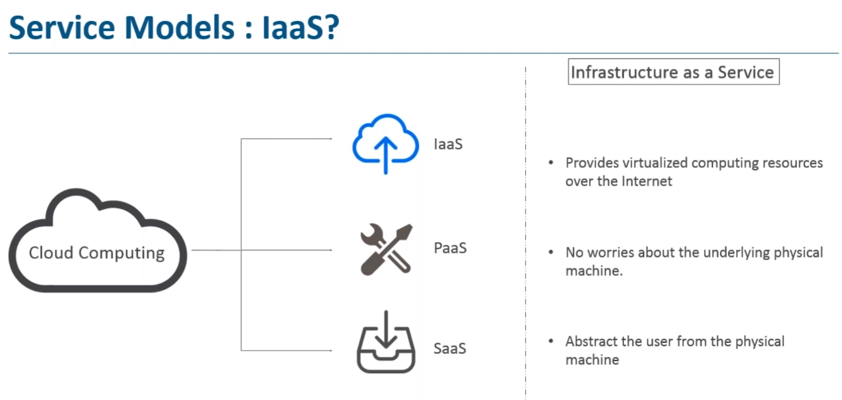

Slide 15
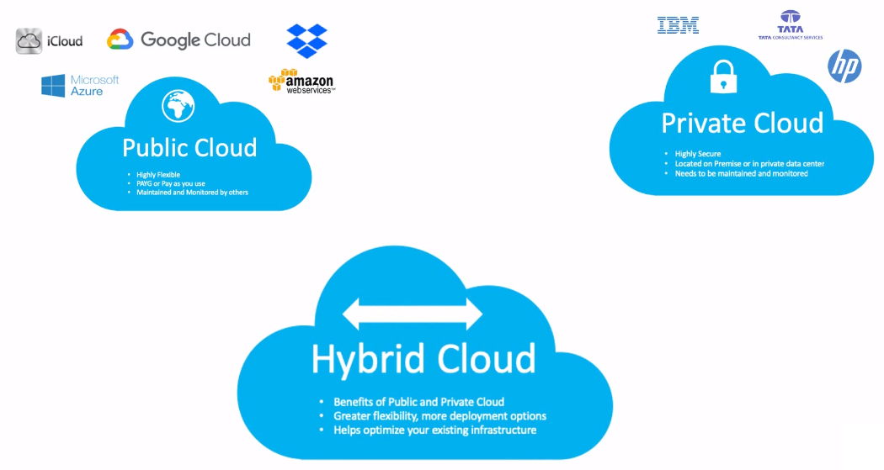

Slide 16
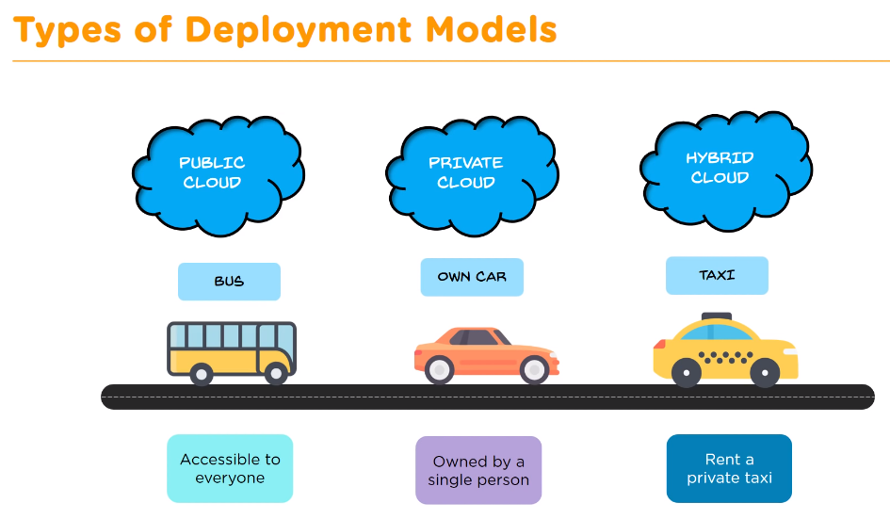

Slide 17
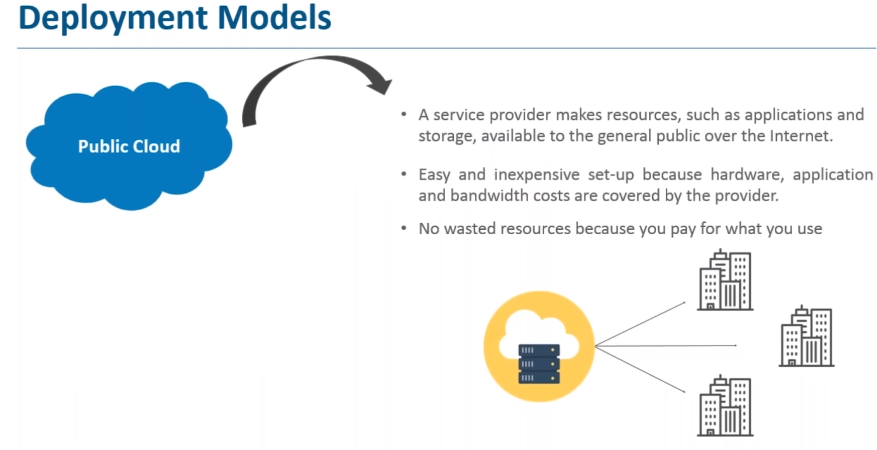

Slide 18
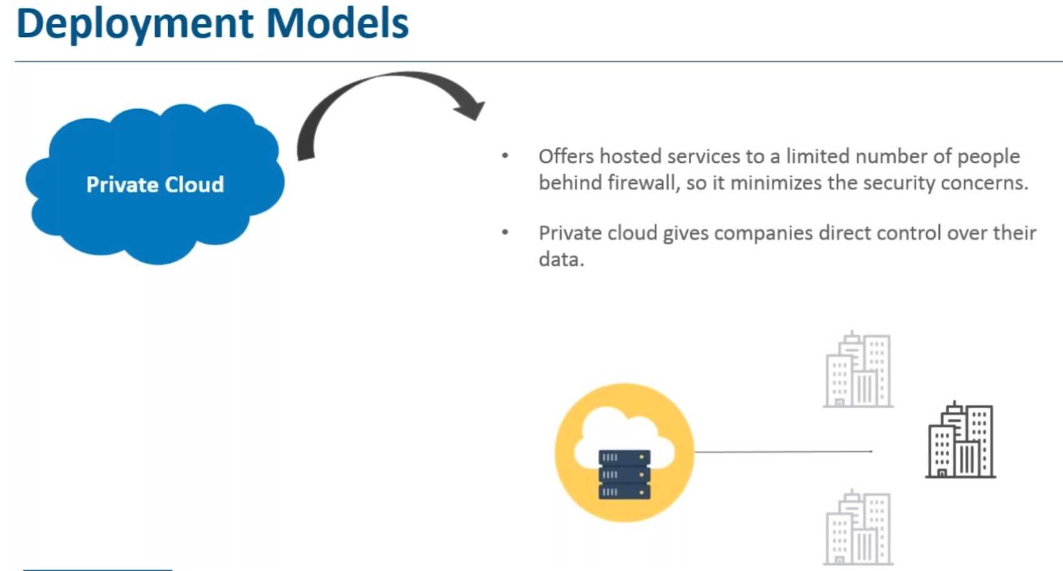

Slide 19
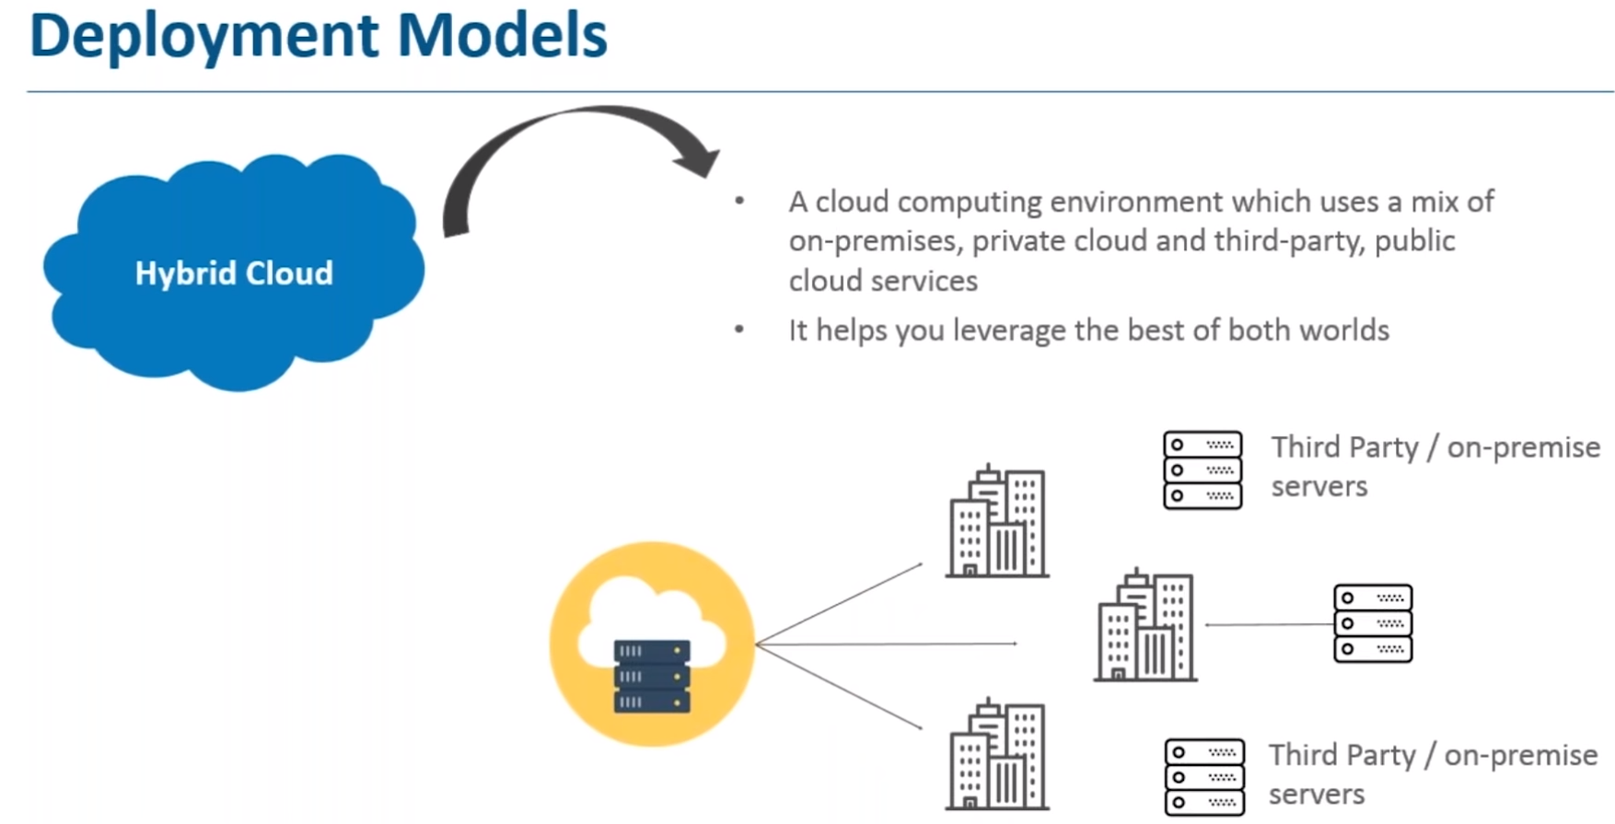

Slide 20
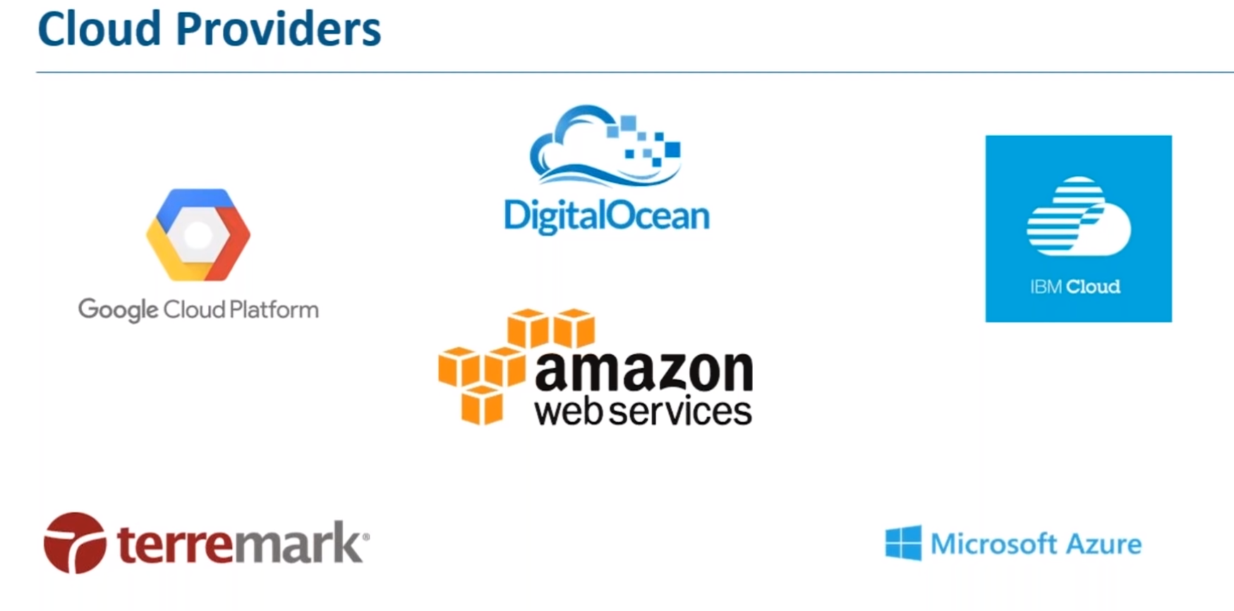

Slide 21
What is Cloud Computing Architecture?
Cloud Computing Architecture is a combination of components required for a Cloud Computing service.
A Cloud computing architecture consists of several components like a front-end platform, a back-end platform or servers, a network or internet service, and a cloud based delivery service.
Cloud computing comprises of two components front end and back end.
Front end consist client part of cloud computing system.
It comprise of interfaces and applications that are required to access the Cloud Computing or Cloud Programming platform.

Slide 22
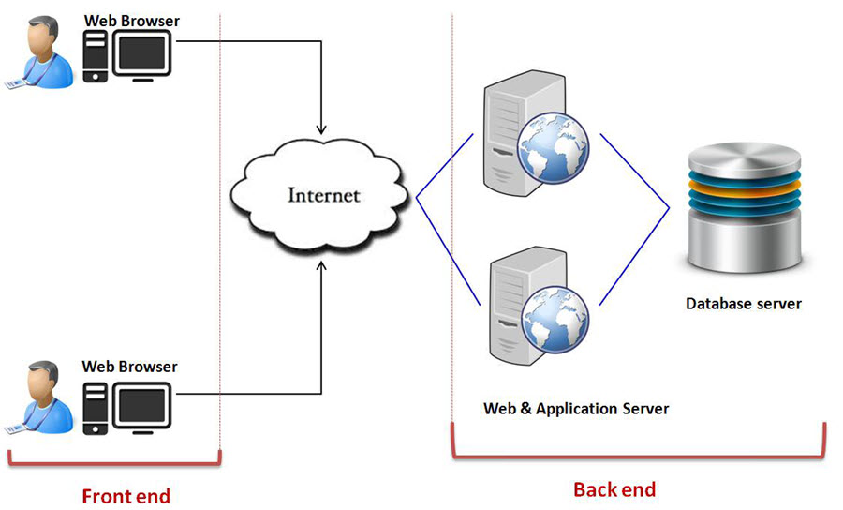

Slide 23
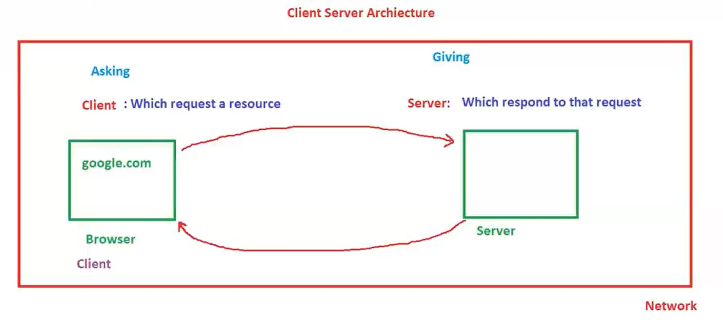

Slide 24
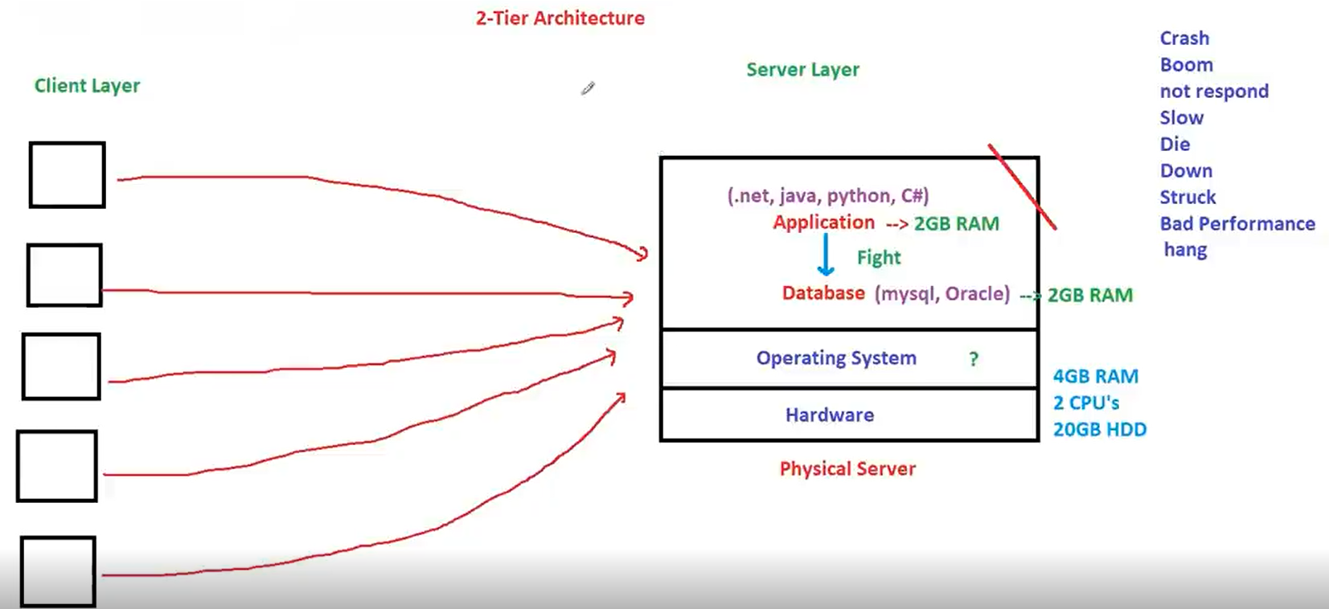

Slide 25
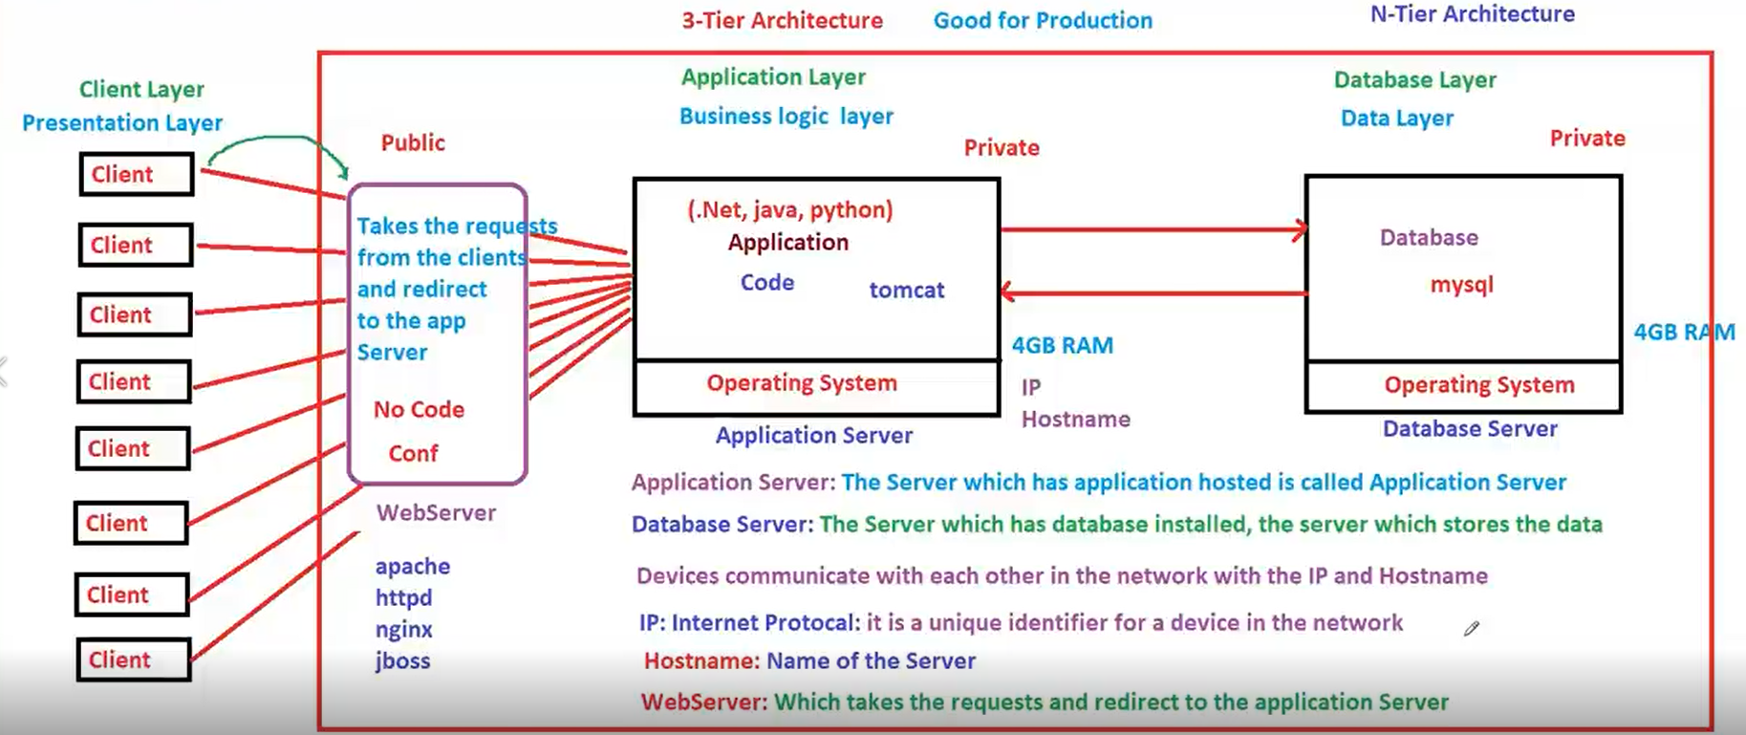

Slide 26
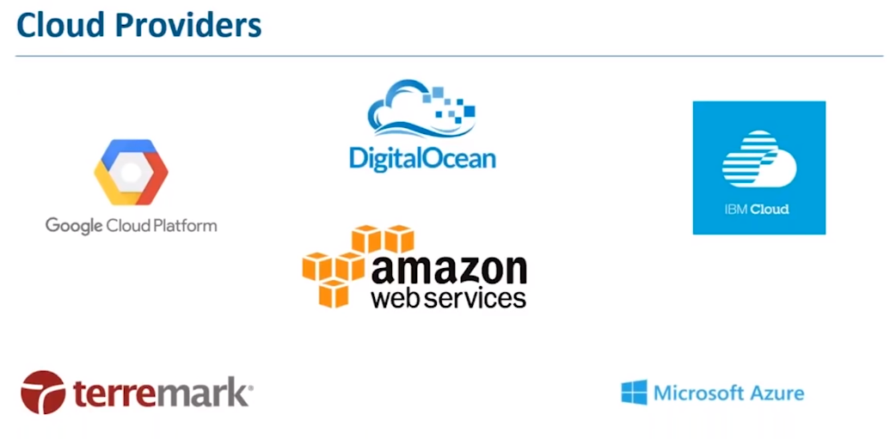

Slide 27
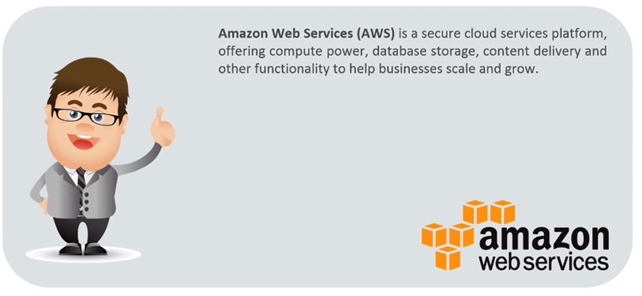
What is AWS?
AWS stands for Amazon Web Service, which is among the most popular cloud platforms. AWS provides developers and organizations with cloud services and helps them stay agile. From multi-million startups to government agencies, many organizations are using AWS. If you want to become a cloud-computing professional, you should learn about AWS. AWS provides a variety of services to its clients.

Slide 28
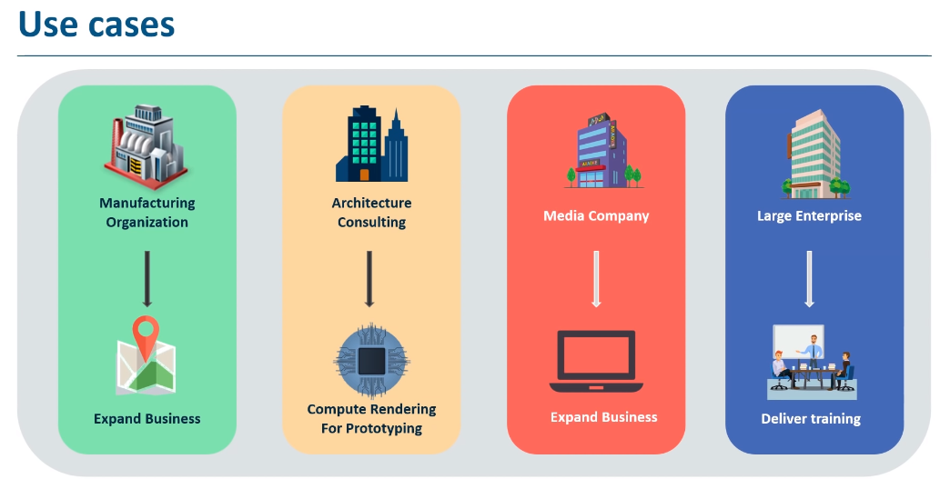

Slide 29
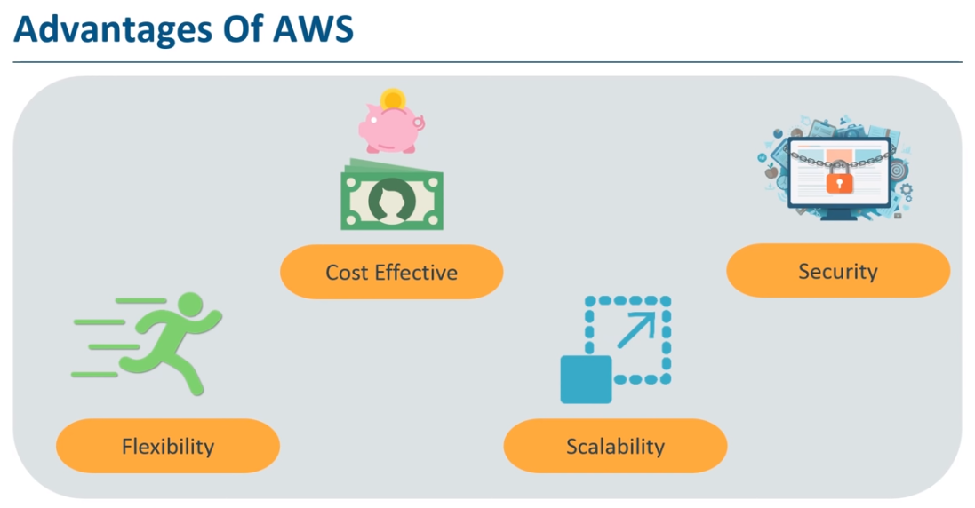

Slide 30


Slide 31
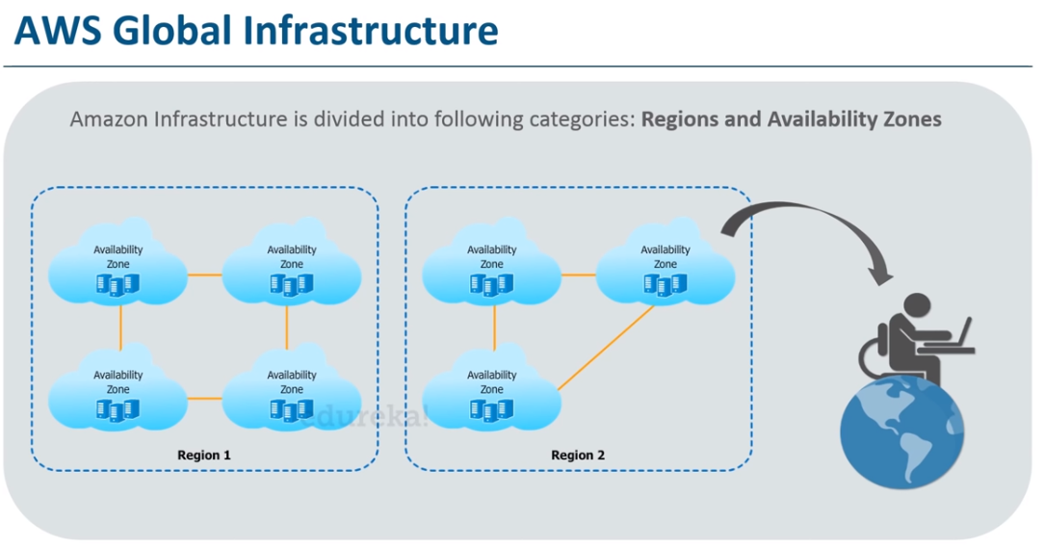

Slide 32
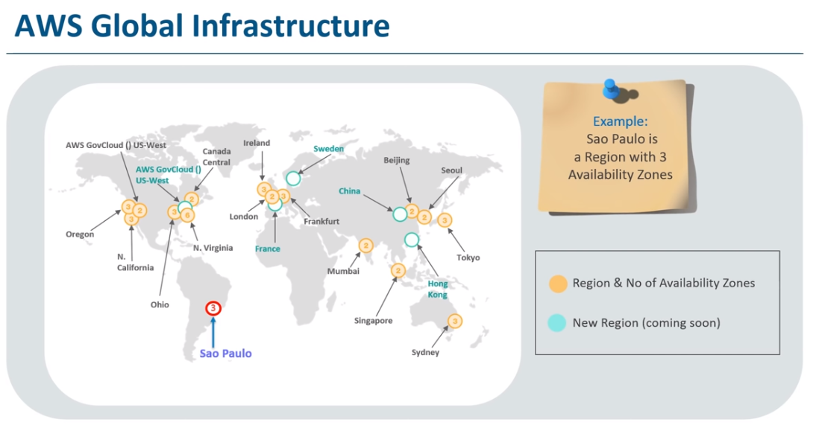

Slide 33
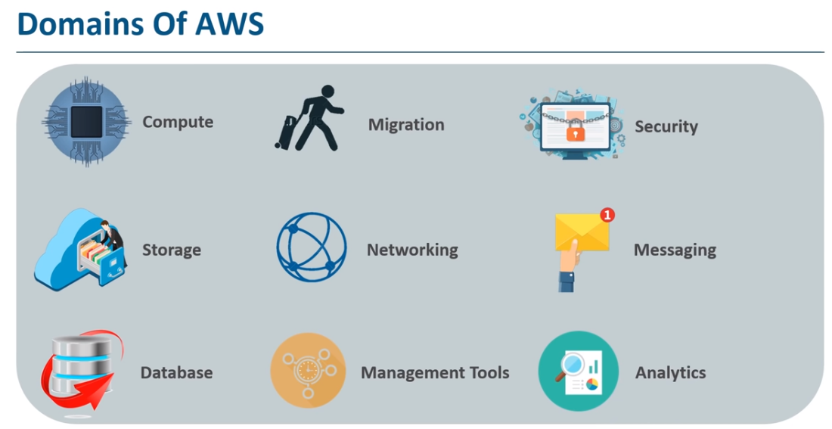

Slide 34
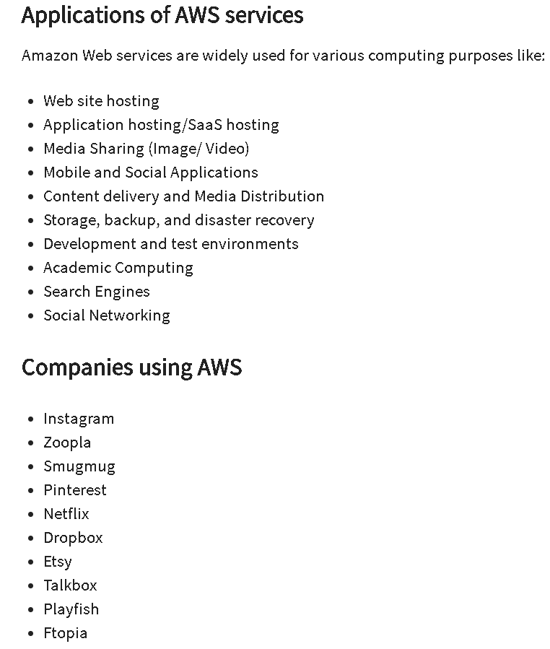

Slide 35
